Slide 1
BIG MART SALES PREDICTION
Bhumika Punjabi
NUID- 001061256
Advisor: Prof Ramkumar Hariharan
INFO6105 Data Sci Eng. Methods Summer Full 2020

Slide 2
Approach Overview
Data Collection
Get Data and split into Train & Test Dataset
Data Visualization to Gain Insights
Data Cleaning
Experimenting with Attribute Combination
Handling Categorical Attributes
Pre-Processing
Select & Train Model
Feature Scaling
Training and Evaluating on Training Set
Better evaluation using Cross-Validation
Fine-Tune your Model
Hyperparameter Tuning
Model Evaluation
Evaluate Model on Test Set

Slide 3
Problem Statement
The data scientists at BigMart have collected 2013 sales data for 1559 products across 10 stores in different cities.
The aim is to build a predictive model and find out the sales of each product at a particular store.
Using this model, BigMart will try to understand the properties of products and stores which play a key role in increasing sales.
Here as we have to predict the sales so it’s a REGRESSION problem!!
Notes:
So the idea is to find out the properties of a product, and store which impacts the sales of a product. Let’s think about some of the analysis that can be done and come up with certain hypothesis.

Slide 4
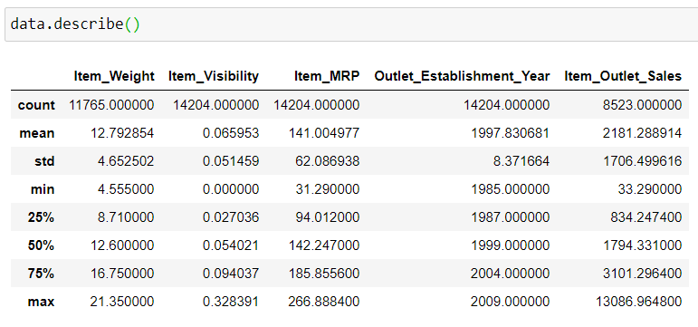
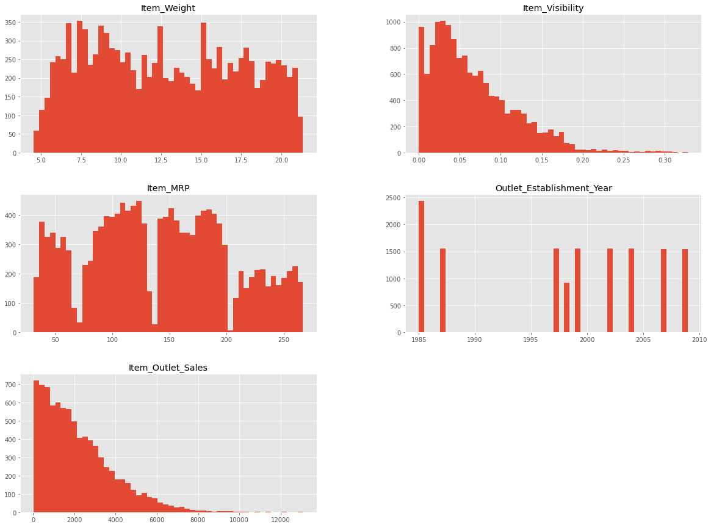
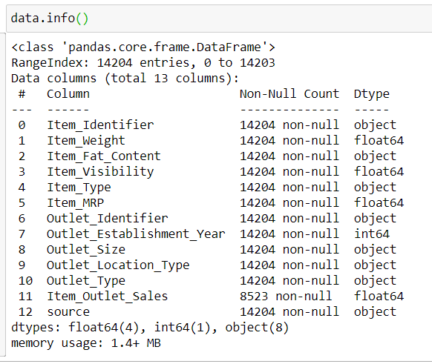
Quick Look at the Data Structure (1/2)
  Item_Visibility has a min value of zero. This makes no practical sense because when a product is being sold in a store, the visibility cannot be 0.
  Outlet_Establishment_Years vary from 1985 to 2009. The values might not be apt in this form. Rather, if we can convert them to how old the particular store is, it should have a better impact on sales.
  The lower ‘count’ of Item_Weight and Item_Outlet_Sales confirms the findings from the missing value check.
Notes:
The describe() method shows a summary of the
numerical attributes
These attributes have very different scales.

Slide 5
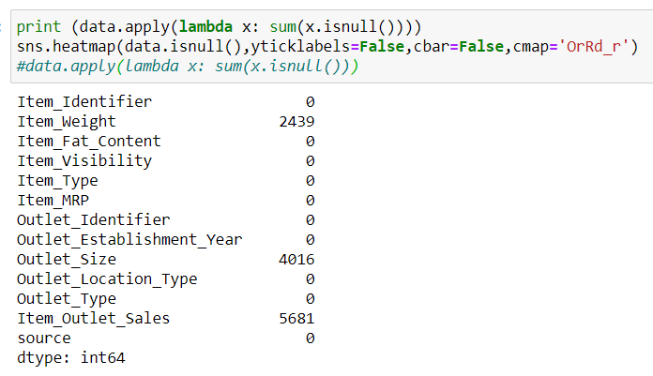
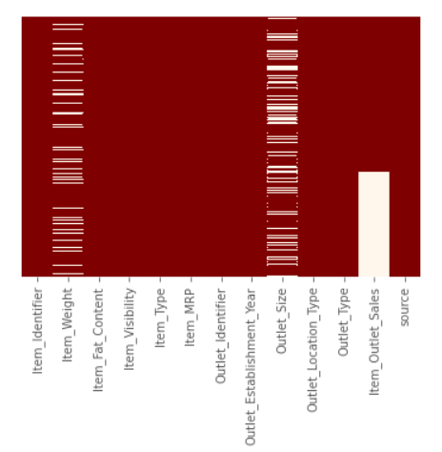
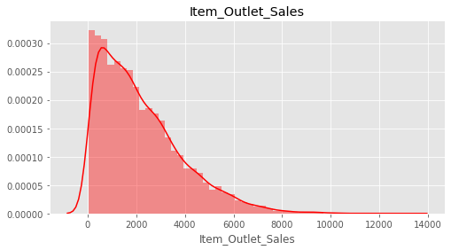
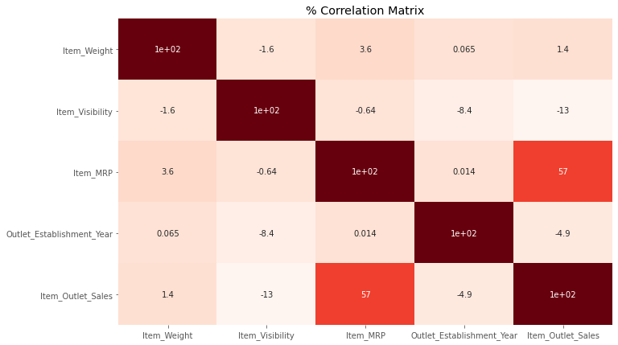
Quick Look at the Data Structure (2/2)
Notes:
So the idea is to find out the properties of a product, and store which impacts the sales of a product. Let’s think about some of the analysis that can be done and come up with certain hypothesis.

Slide 6
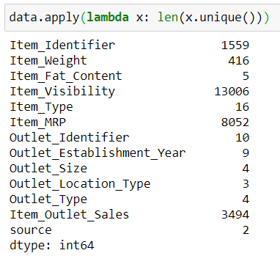
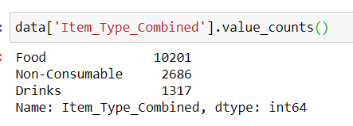
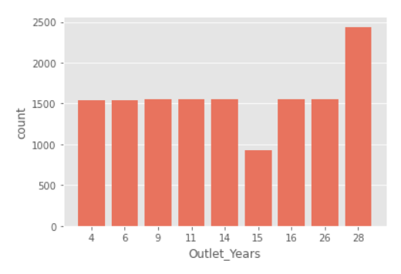
Data Pre-Processing (1/2)
Imputing Missing Values
We found two variables with missing values – Item_Weight and Outlet_Size and used the following way to deal with it:
  Used average weight of the particular item for Item_Weight
  Used mode of the Outlet_Size for the particular type of outlet for Outlet_Size
We noticed that the minimum value for Item_Visibility is 0, which makes no sense, so we considered it as a missing value scenario and imputed the 0 value with mean visibility of that product.
New Attributes
Item_Type variable has 16 categories, and its an important feature to predict the sales. So we experimented with combining them into small no of categories.
Item_Identifier, is a unique ID of each item, so we have used the Item_Identifier variable to create a new column: Item_Type_Combined which contains 3 categories Food, Drinks and Non-Consumables.
Created a new variable denoting the years of operation of a store : Outlet_Years
Notes:
So the idea is to find out the properties of a product, and store which impacts the sales of a product. Let’s think about some of the analysis that can be done and come up with certain hypothesis.

Slide 7
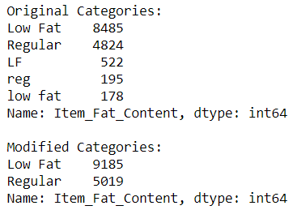
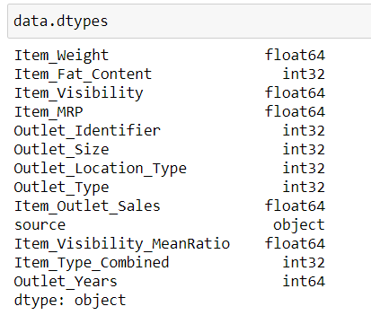
Data Pre-Processing (2/2)
New Attributes (Contd.)
On careful observation it was found that different representations were used to categorize the fat content in variable Item_Fat_Content, so we corrected the representation.
For the non-consumables a fat-content should not be specified, we added a separate category (“Non-Edible”) for that case.
Handling Categorical Attributes
Converted all categorical variables as numeric using ‘LabelEncoder’ from sklearn’s preprocessing module.
In the attached snapshot we can see that all variables are now in numerical format.
Notes:
So the idea is to find out the properties of a product, and store which impacts the sales of a product. Let’s think about some of the analysis that can be done and come up with certain hypothesis.

Slide 8
Select & Train Model (1/8)
Here we have used the following 5 different predictive models
    Liner Regression
    Decision Tree
    Random Forest
    XGBoost
    Deep Neural Network
Notes:
So the idea is to find out the properties of a product, and store which impacts the sales of a product. Let’s think about some of the analysis that can be done and come up with certain hypothesis.

Slide 9
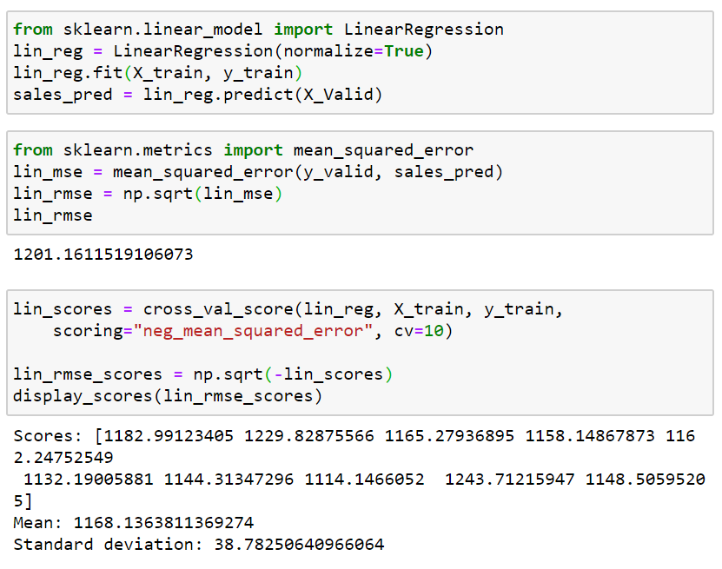
Select & Train Model (2/8)
Linear Regression
Fitted a Linear Regression model to the data and computed RMSE for the validation dataset.
X_Valid RMSE = 1201
Notes:
So the idea is to find out the properties of a product, and store which impacts the sales of a product. Let’s think about some of the analysis that can be done and come up with certain hypothesis.

Slide 10
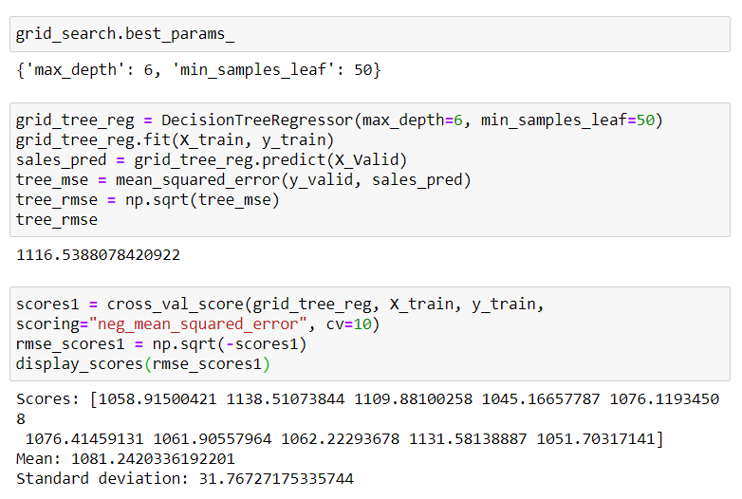
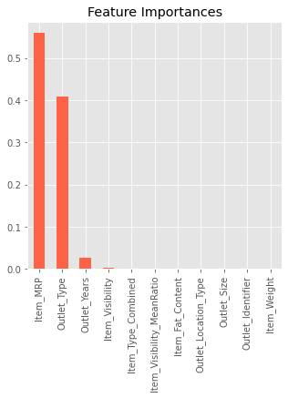
Select & Train Model (3/8)
Decision Tree
Parameters:
  max_depth=6
  min_samples_leaf=50
X_Valid RMSE = 1116
CV Score = 1081
Notes:
So the idea is to find out the properties of a product, and store which impacts the sales of a product. Let’s think about some of the analysis that can be done and come up with certain hypothesis.

Slide 11
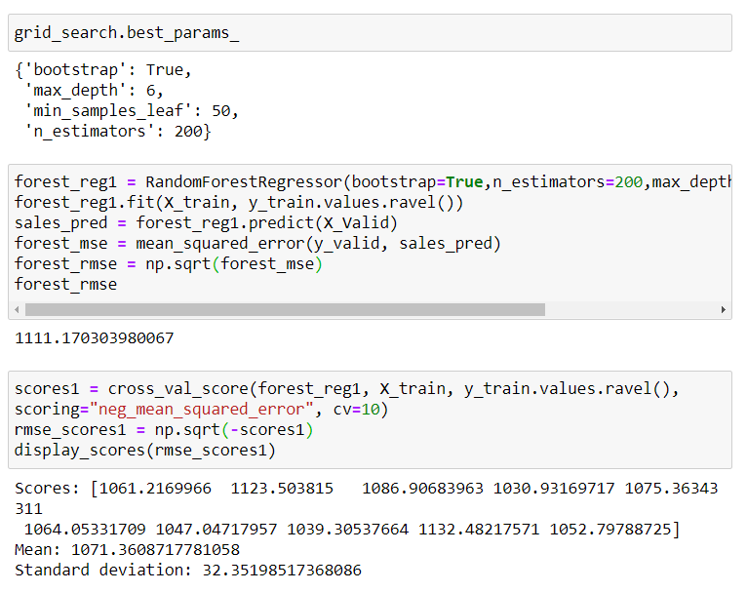
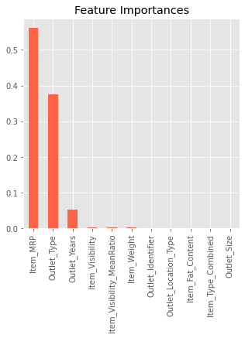
Select & Train Model (4/8)
Random Forest
Parameters:
  n_estimators=200
  max_depth=6
  min_samples_leaf=50
  Bootstrap=True
X_Valid RMSE = 1111
CV Score = 1071
Notes:
So the idea is to find out the properties of a product, and store which impacts the sales of a product. Let’s think about some of the analysis that can be done and come up with certain hypothesis.

Slide 12
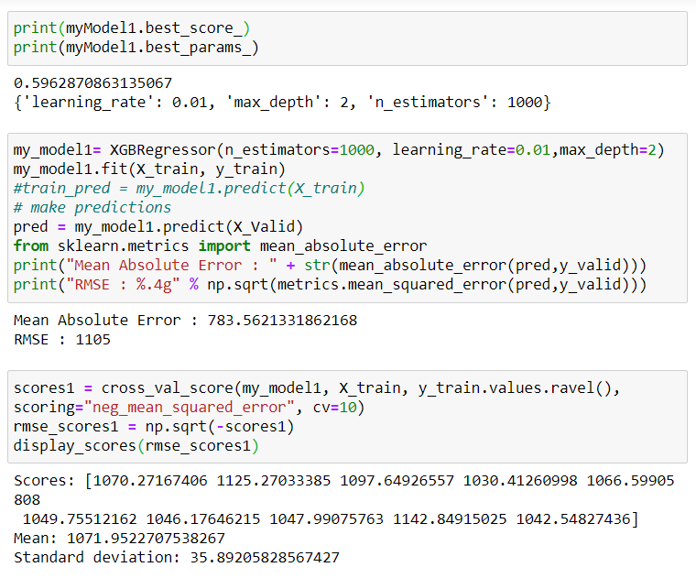
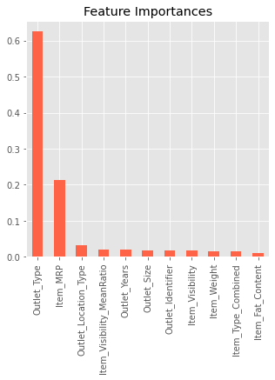
Select & Train Model (5/8)
XGBoost
Parameters:
  n_estimators=500
  learning_rate=0.01
  max_depth=6
X_Valid RMSE = 1105
CV Score = 1071
Notes:
So the idea is to find out the properties of a product, and store which impacts the sales of a product. Let’s think about some of the analysis that can be done and come up with certain hypothesis.

Slide 13
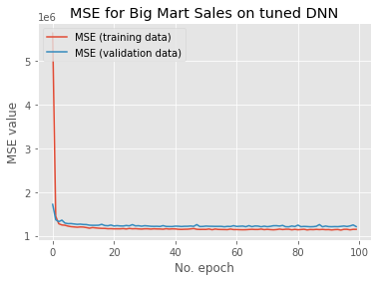
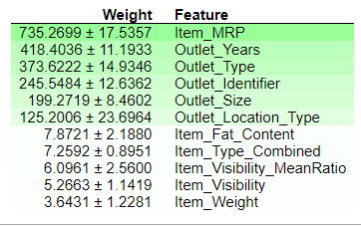
Select & Train Model (6/8)
Deep Neural Network
Parameters:
  2 Hidden Layers
  input_dim = 11
  Neuron1 = 200
  Neuron1 = 100
  kernel_initializer= normal
  Dropout = 0.1
  activation= relu
  epochs =100
  batch_size = 150
X_Valid RMSE = 1096
Notes:
So the idea is to find out the properties of a product, and store which impacts the sales of a product. Let’s think about some of the analysis that can be done and come up with certain hypothesis.

Slide 14
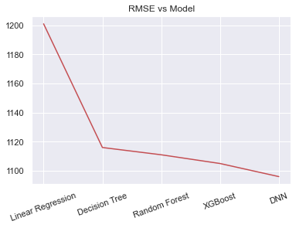
Select & Train Model (7/8)
Based on RMSE we selected DNN for predicting sales for test dataset
Notes:
So the idea is to find out the properties of a product, and store which impacts the sales of a product. Let’s think about some of the analysis that can be done and come up with certain hypothesis.

Slide 15
Select & Train Model (8/8)
Model | RMSE | CV Score
Linear Regression | 1201 | 1168
Decision Tree | 1116 | 1081
Random Forest | 1111 | 1071
XGBoost | 1105 | 1071
DNN | 1096 | -
Based on RMSE we selected DNN for predicting sales for test dataset
Notes:
So the idea is to find out the properties of a product, and store which impacts the sales of a product. Let’s think about some of the analysis that can be done and come up with certain hypothesis.

Slide 16
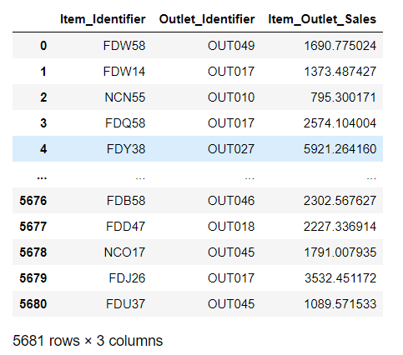
Model Evaluation on Test Dataset (1/2)
After working with different models, we eventually have a system that performs sufficiently well.
On evaluating the final model on the test set we get the predicted sales (“Item_Outlet_Sales”) of each product at a particular store.
Notes:
So the idea is to find out the properties of a product, and store which impacts the sales of a product. Let’s think about some of the analysis that can be done and come up with certain hypothesis.

Slide 17
THANK YOU!!

